Slide 1
Authenticity Rules
How to be a Real
& Real Good Presenter

Slide 2
The Gravity Rule
Know Your Self

Slide 3
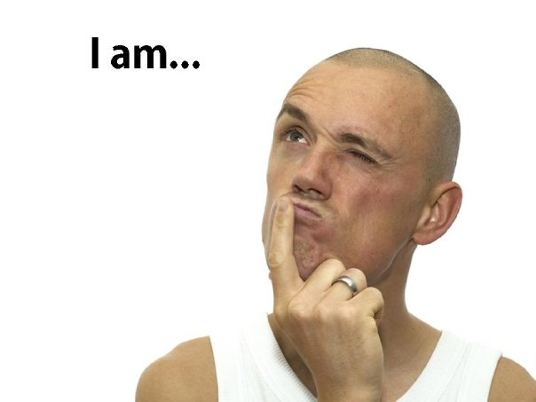

Slide 4
The Iceberg Rule
Know Your Content

Slide 7
The YourSpace Rule
Know Your Audience

Slide 8
The Surgeon Rule
Know Your Tools

Slide 9
The 7-Iron Rule
Know Your Flow

Slide 11
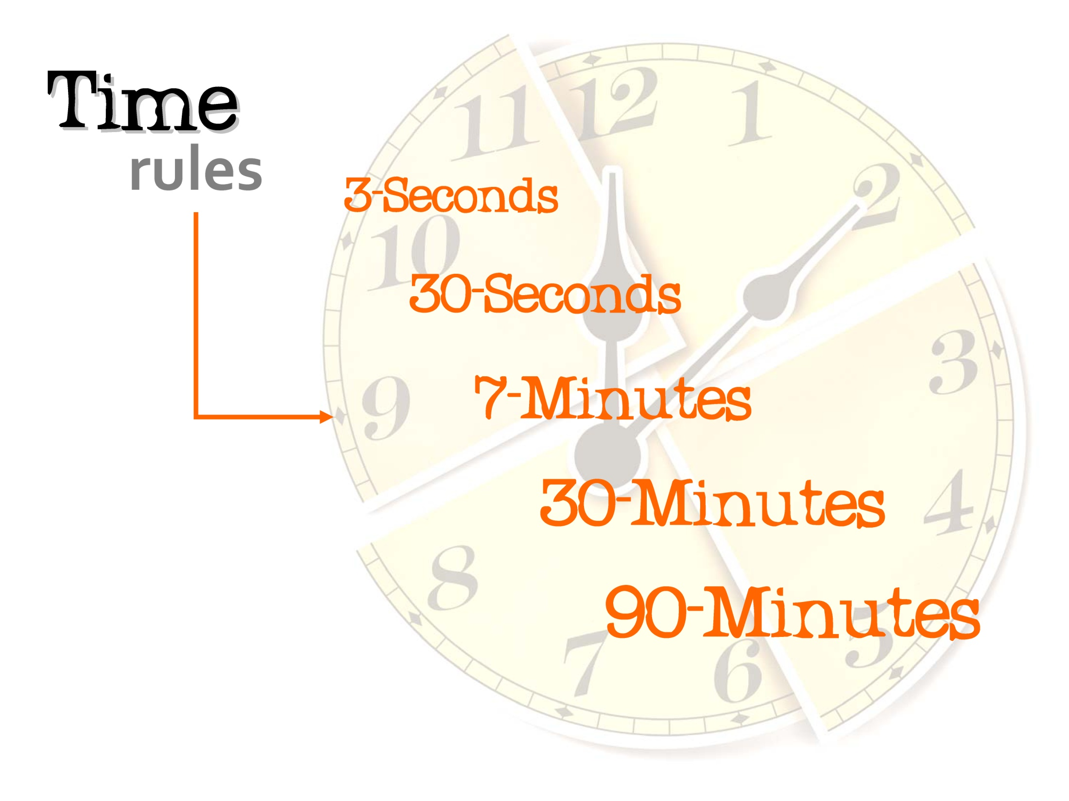

Slide 12
The Mask Rule
Know Your Enemies

Slide 15
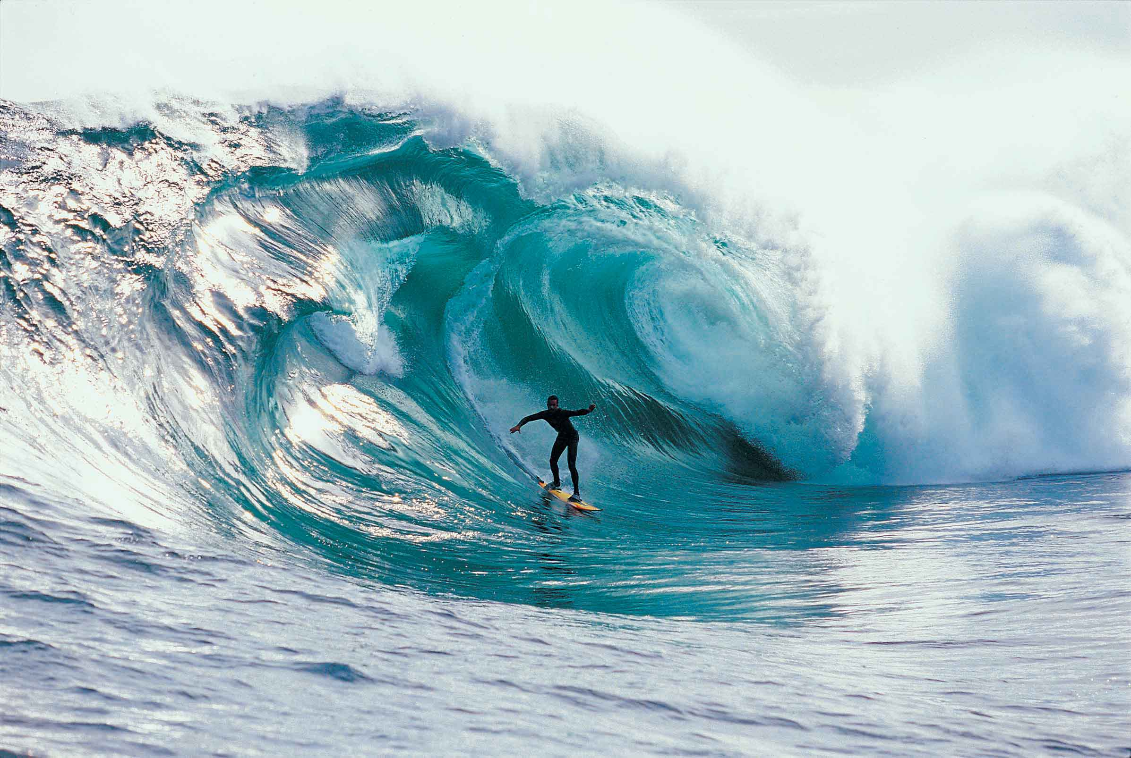
The Mavericks Rule
Know Your Difference-Makers

Slide 16
Authenticity Rules
Learn more
Rhett@YourNextSpeaker.com

