Slide 1
Its a
Breeze
How to Control Your Time

Slide 2
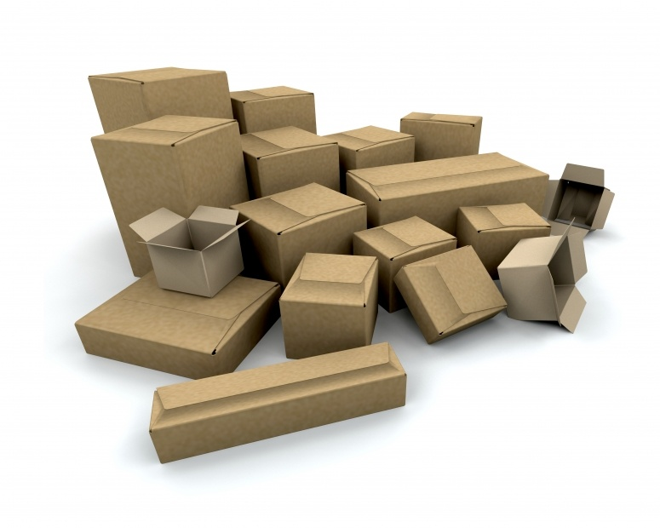
list
stress over
Stuff
trash
move
hoard
organize
need
collect

Slide 3
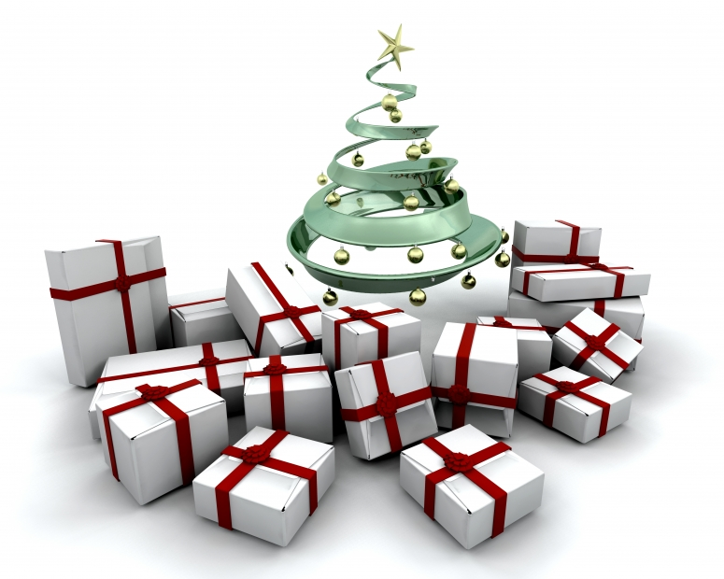
look forward to
Stuff

Slide 4
THE BOX PRINCIPLE
Time and Attention are Finite
Options and Distractions are Infinite
“
Lousy in = Cool out.
Credit: Merlin Mann

Slide 5
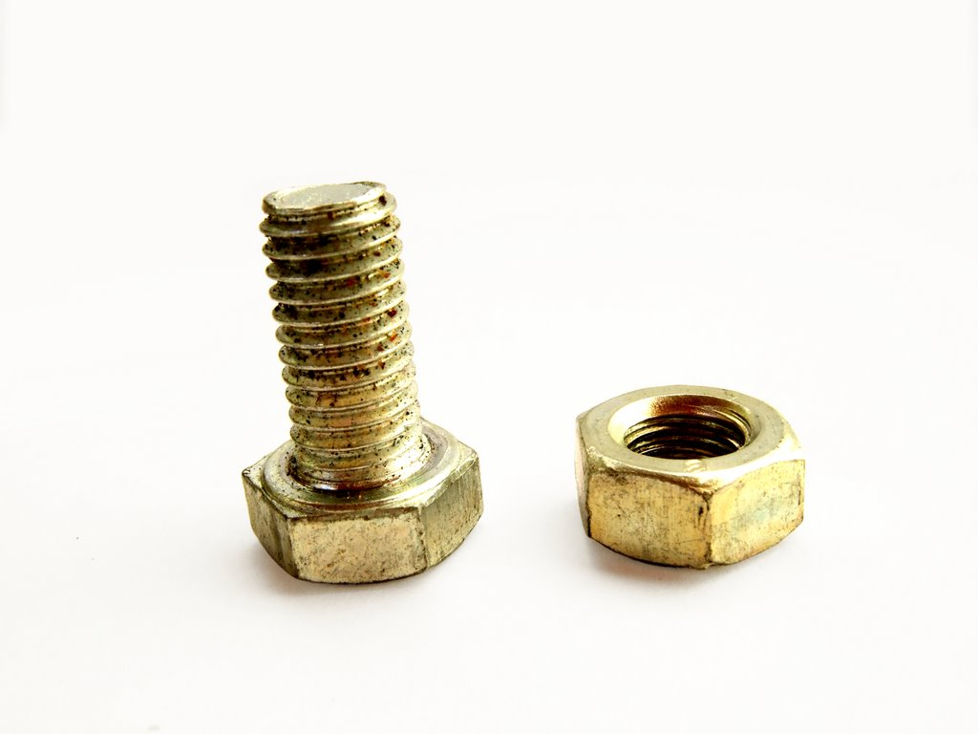
TECHNIQUES

Slide 6
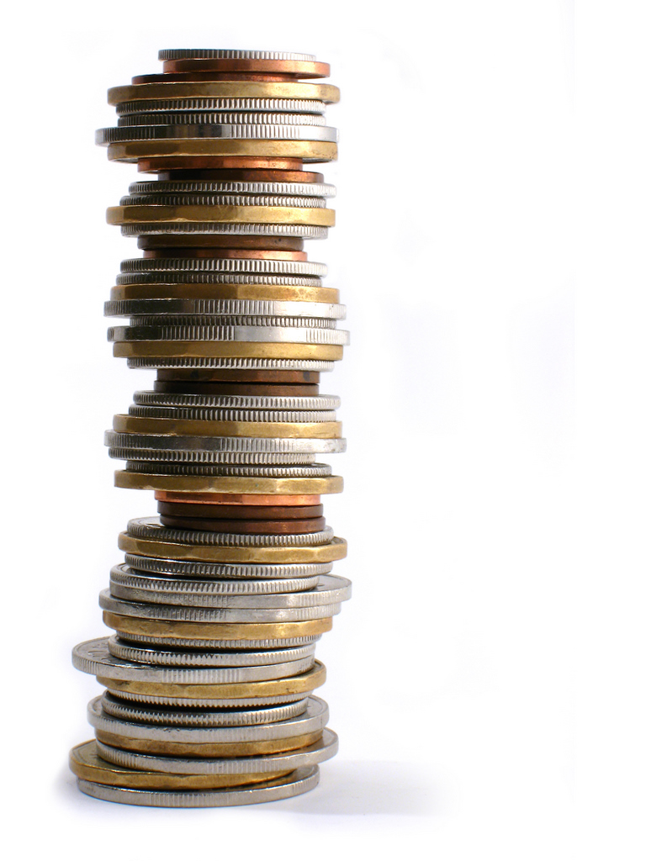
T-COIN
Take Care Of It Now
[2 Minutes or Less]
Getting Things Done : David Allen
[The Bankruptcy of Repetition]

Slide 7
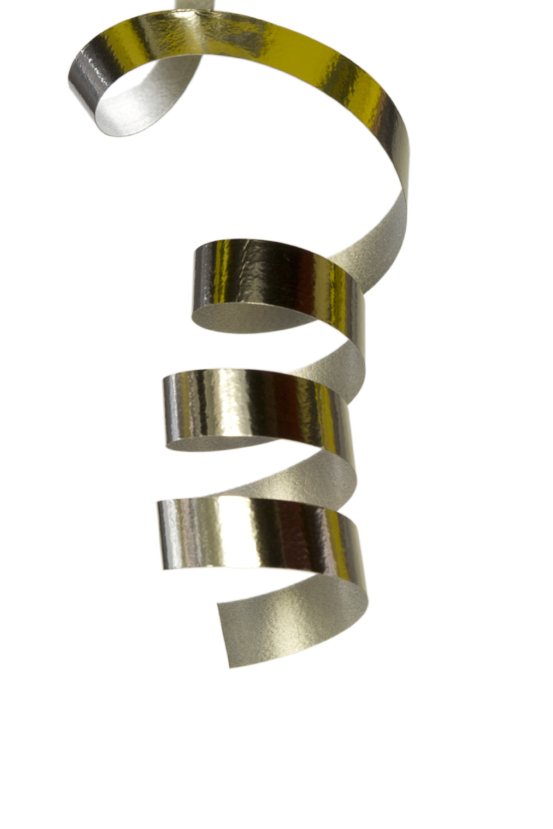
OPEN
LOOPS
Credit: David Allen

Slide 8
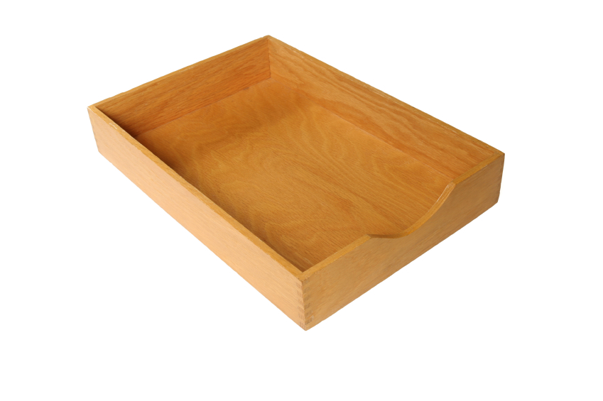
When you do read…
Take immediate action
Delegate w/specifics
Move to task list
Archive
ZERO INBOX
Credit: Merlin Mann
*CLASSIC T-COIN THINKING

Slide 9
To-Do
LISTS
Actionable Items Only
Day Before List
Eat the Big Frog First

Slide 10
PRODUCTIVITY
WINDOWS
Maximize your efficient times

Slide 11
Rhett’sBLOGS
www.PersonalLeadershipInsight.com
www.AuthenticityRules.com
&
Leadership Presentation Skills Content

Slide 12
Rhett’sNETWORK
facebook.com/rhettlaubach
twitter.com/rhettlaubach
linkedin.com/in/rhettlaubach

Slide 13
@
rhett
yournextspeaker.com

