Slide 1
CONFERENCE PLANNING
SUCCESS STRATEGIES
By Rhett Laubach

Slide 2
Keep the agenda simple

Slide 3
Double check all AV

Slide 4
Put together a script

Slide 5
Big and Bold Signage

Slide 6
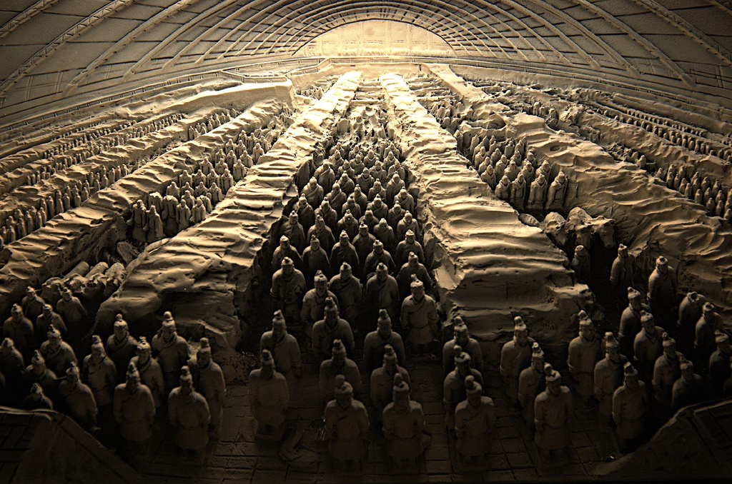
Multiple Registration Lines
Multiple Food Lines

Slide 7
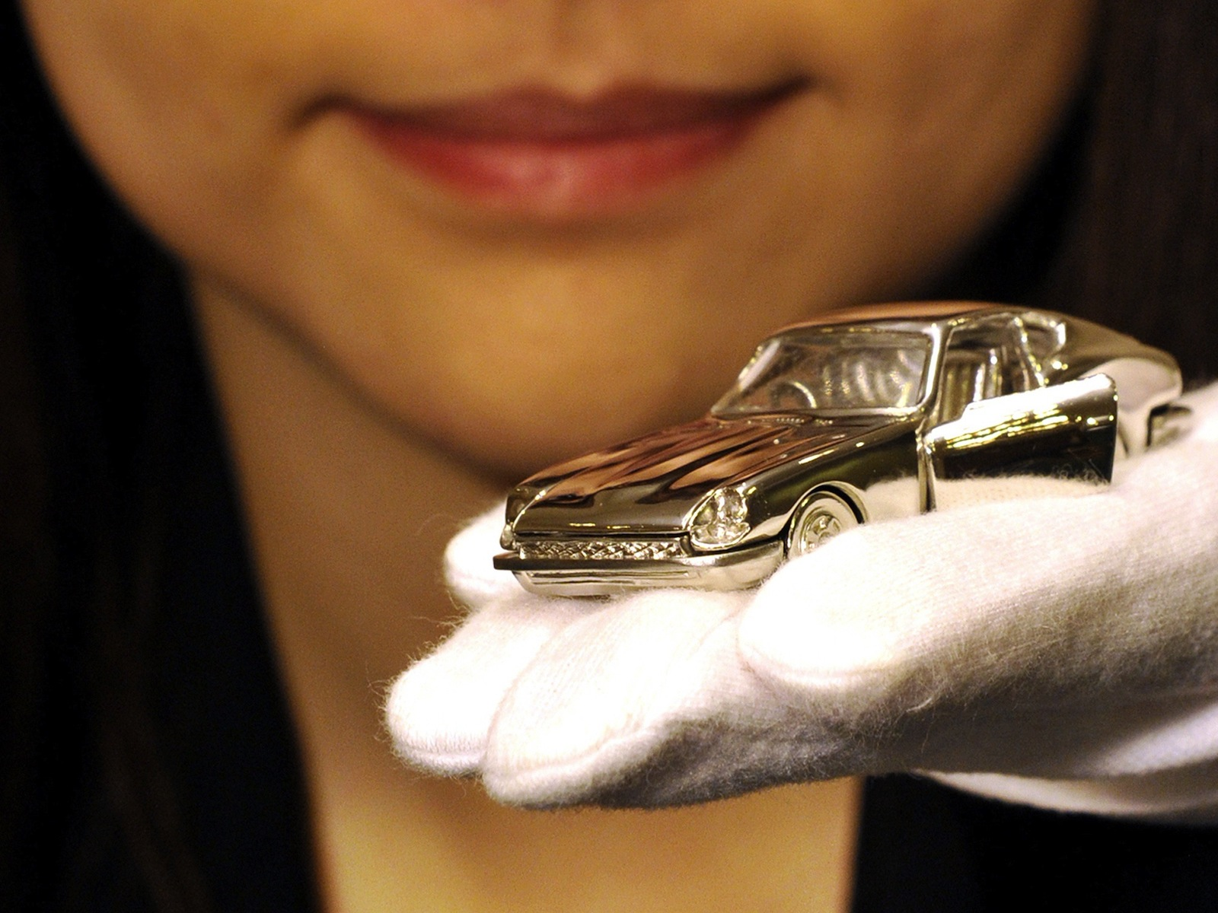
Few Door Prizes

Slide 8
Assign Roamers
To help wherever they are needed

Slide 9
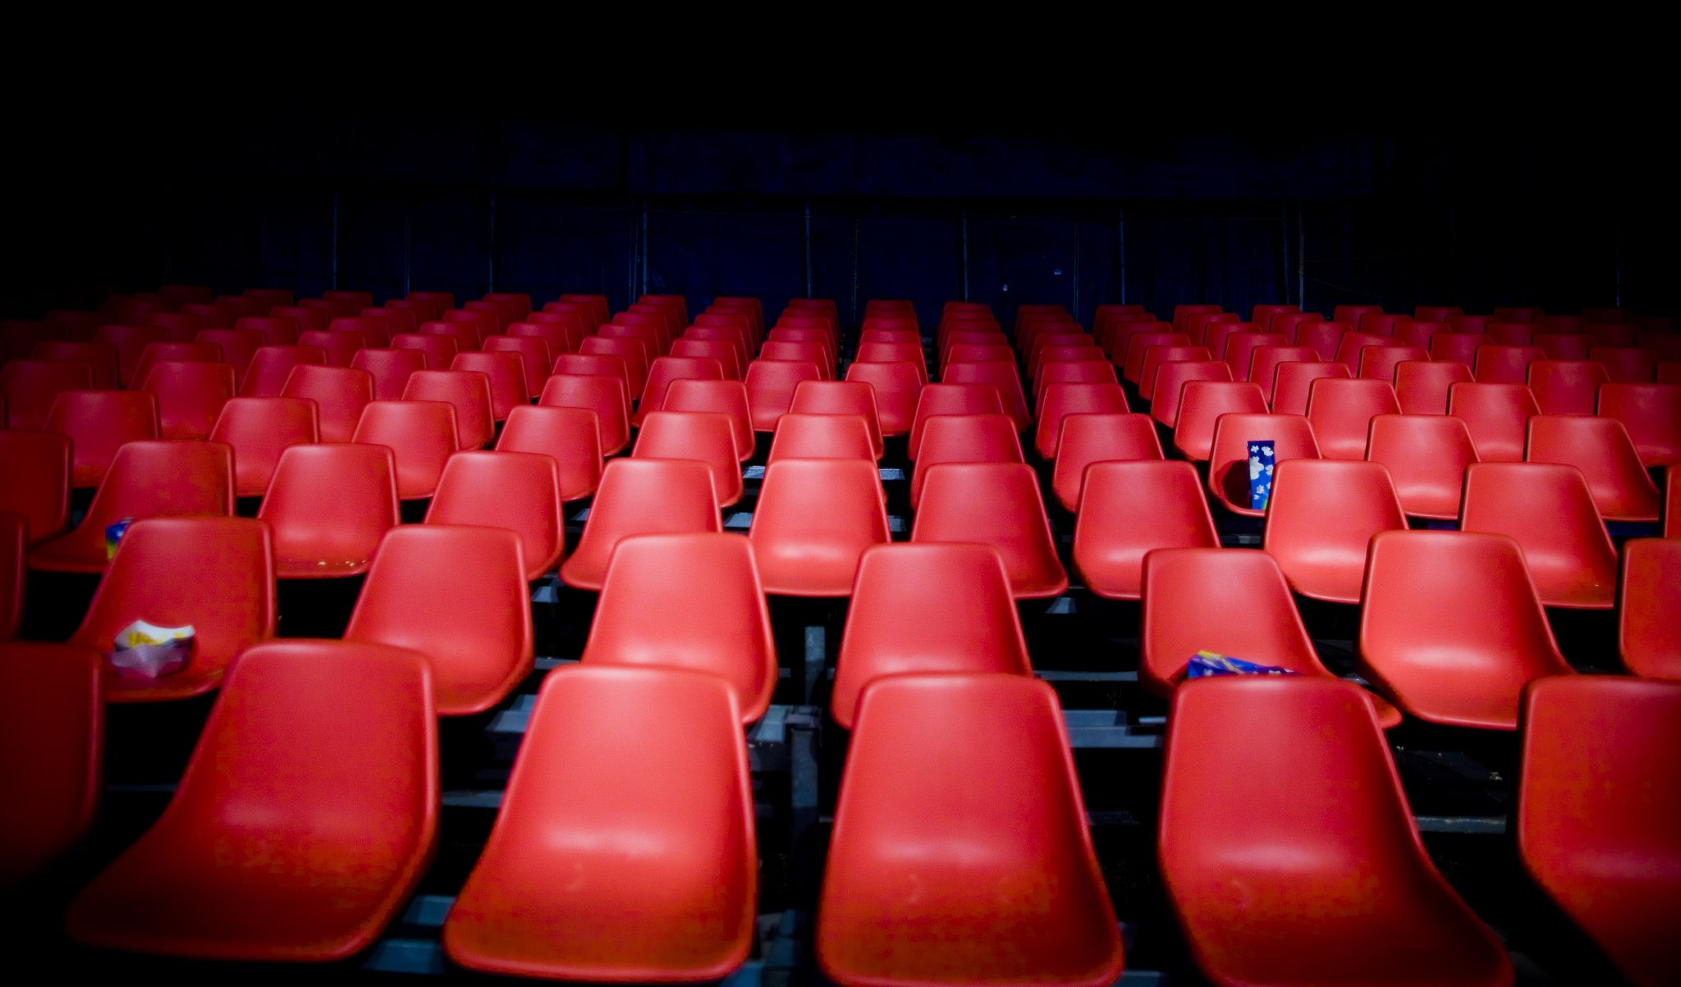
The Facility is Everything
Cool the air. Sit everyone close. Remove distractions.

Slide 10
Show up Early to Set-Up

Slide 11
Alert the Media

Slide 12
Bonus 6 List:
Make the room cool
Invite dignitaries to speak
Rope off the back rows
Bring “multiples” up at once
Expect to start late
Expect everything to run long

Slide 13
Rhett’s Leadership Blog
www.PersonalLeadershipInsight.com
Rhett’s Speaking Skills Blog
www.AuthenticityRules.com
Rhett’s Company Website
www.YourNextSpeaker.com

