Slide 1
Make an
IMPACT
Excellent Customer
Service Principles
© 2016 Rhett Laubach

Slide 2
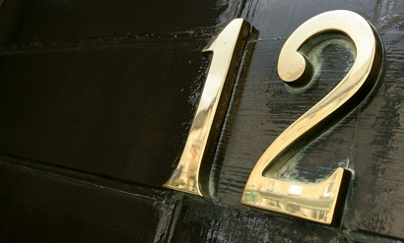
What does great customer service look like?
Excellent
Service
Principles

Slide 3
THE 7-IRON PRINCIPLE
Excellent service is elemental.

Slide 4
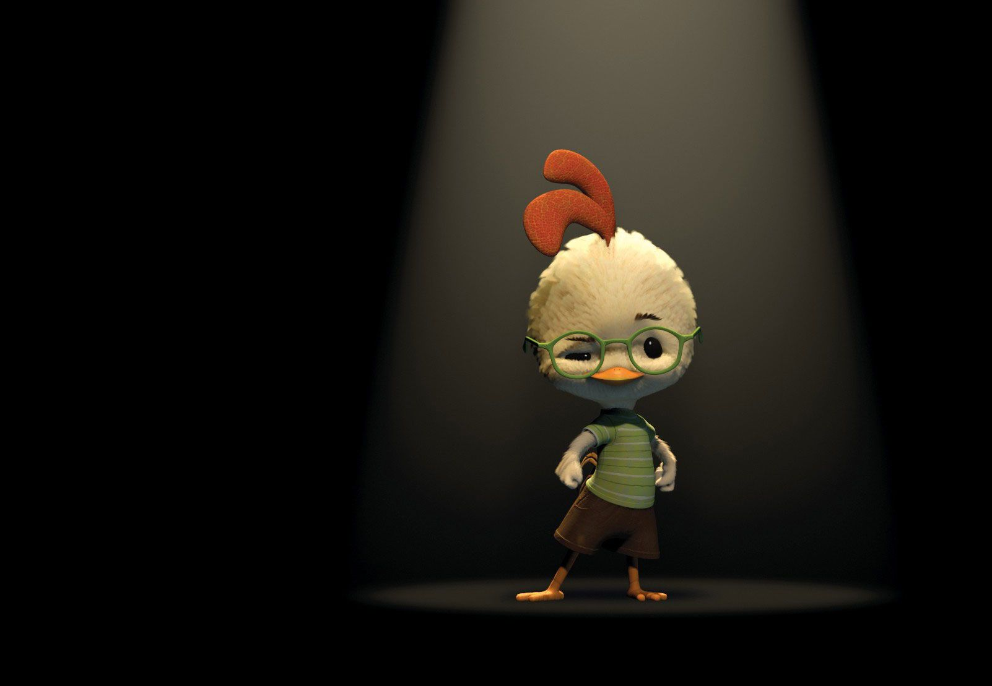
THE CHICKEN LITTLE PRINCIPLE
Emphasize the positive.

Slide 5
THE OPEN SPACE PRINCIPLE
Build on what works.

Slide 6
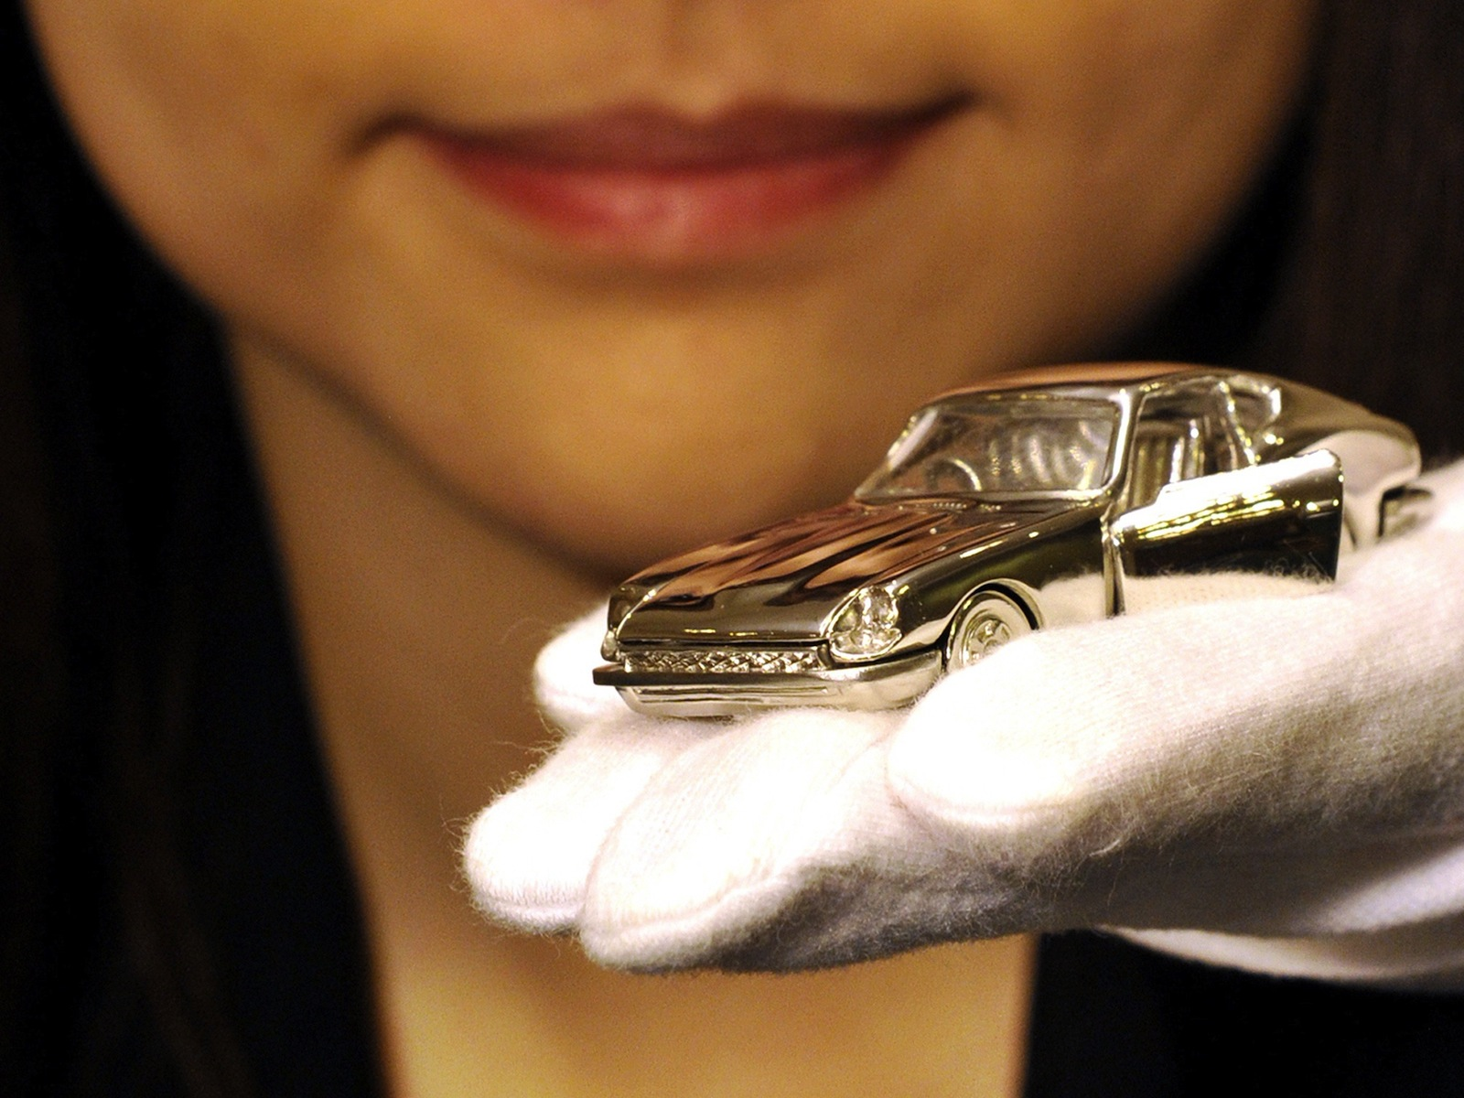
THE PLATINUM RULE PRINCIPLE
“Do unto others as they’d like done unto them.”
Tony Alessandra

Slide 7
THE TONY
BENNETT
PRINCIPLE
Have a veteran’s expertise and a novice’s energy.

Slide 8
THE IRVING PRINCIPLE
Get clear on why you are successful.

Slide 9
THE FRESH AIR
PRINCIPLE
Ask great questions.

Slide 10
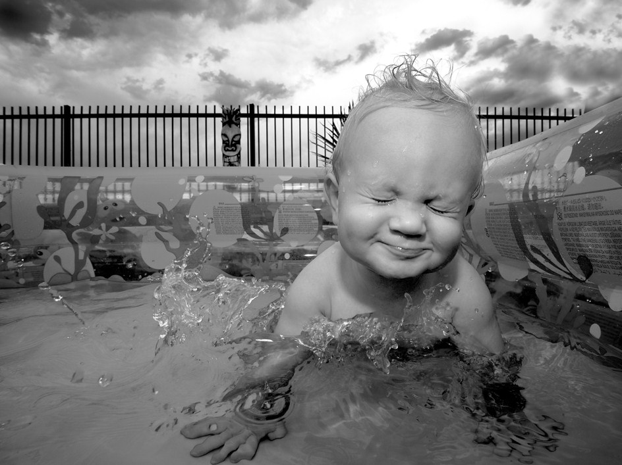
THE TODDLER PRINCIPLE
Friendly first.

Slide 11
THE TOYOTA PRINCIPLE
Enable and encourage problem solving right now.

Slide 12
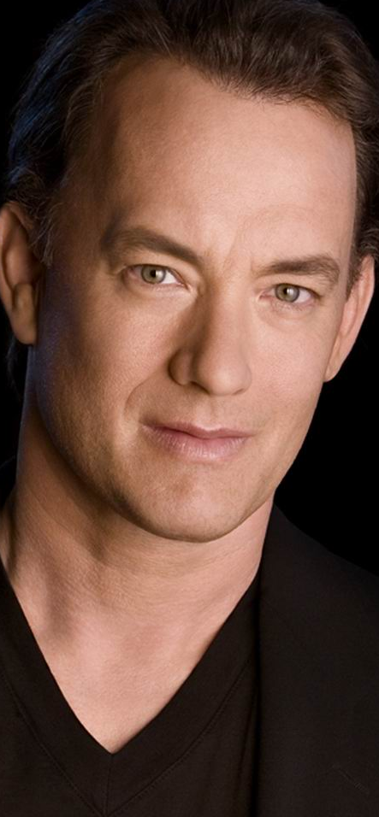
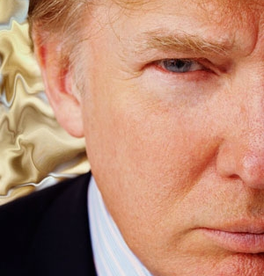
THE WALKING BILLBOARD PRINCIPLE
….

Slide 13
THE WALKING BILLBOARD PRINCIPLE
You are the brand.

Slide 14
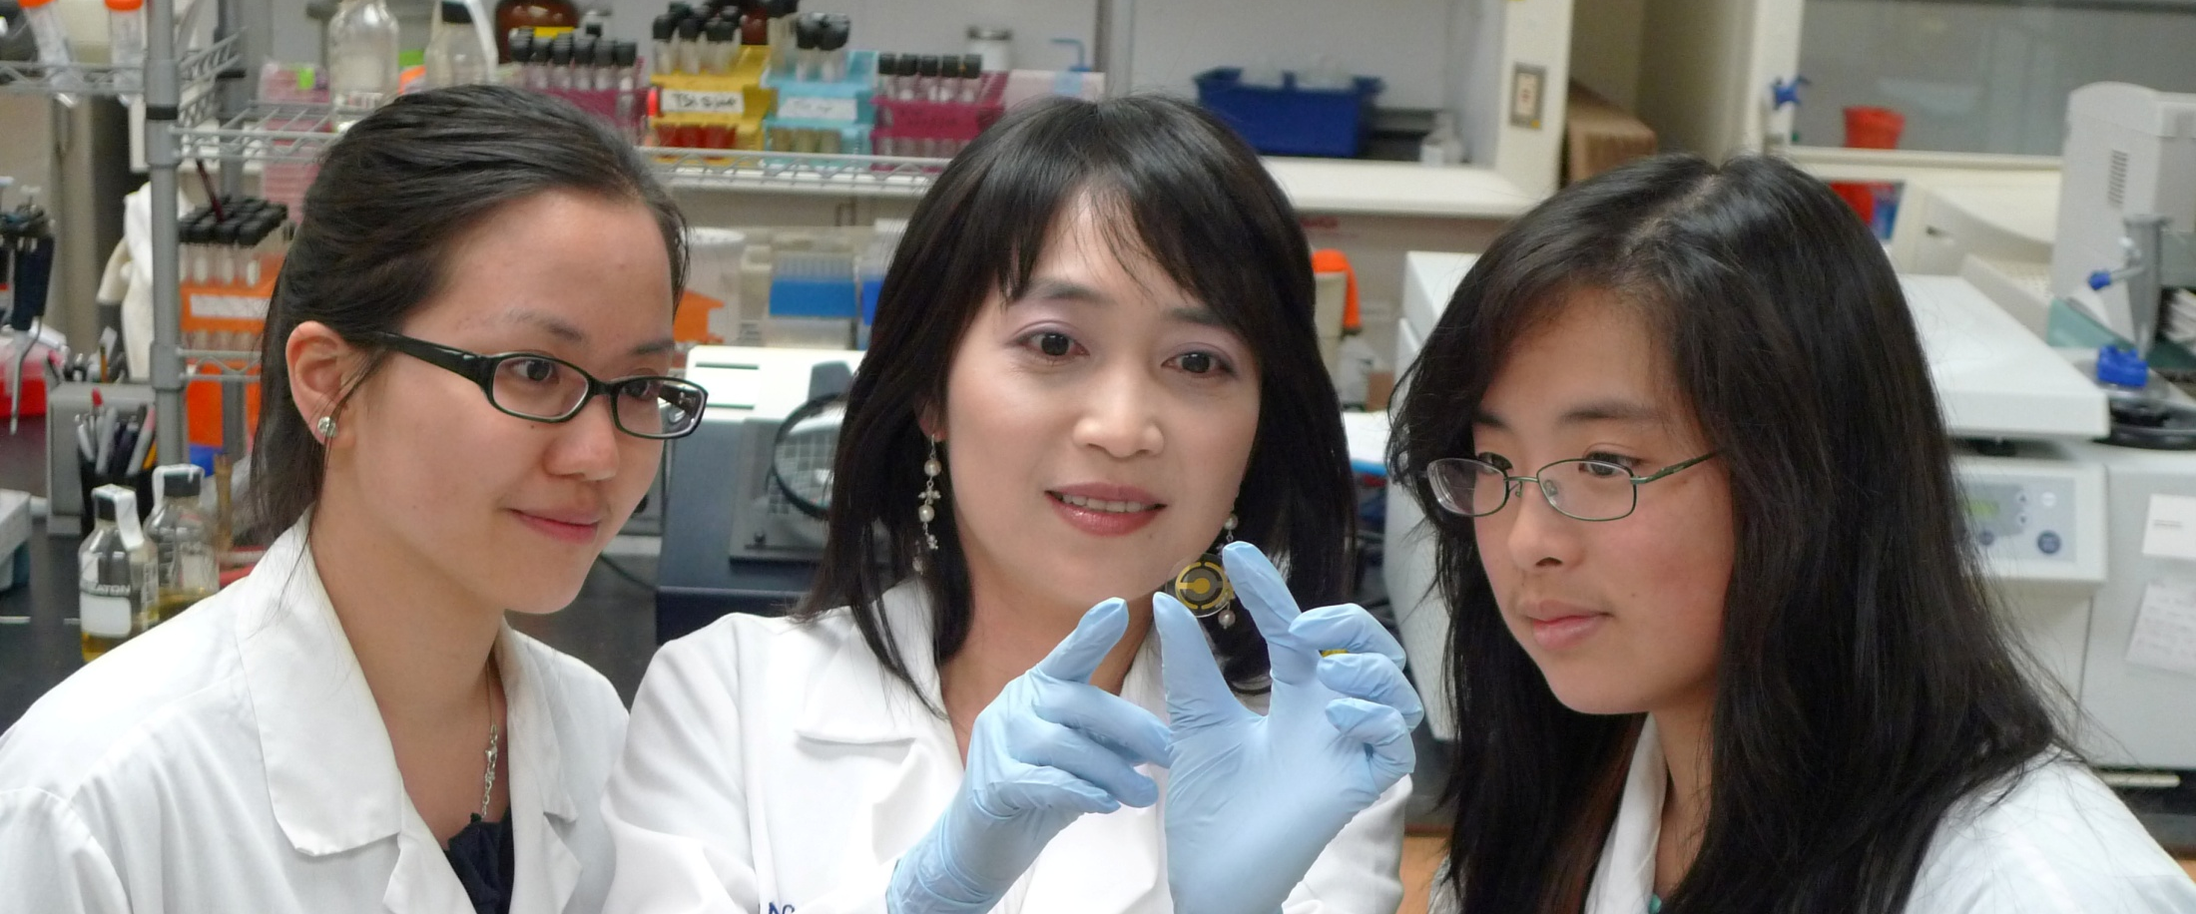
THE YOURSPACE PRINCIPLE
Your way + My way = Our Way

Slide 15
THE THUNDER PRINCIPLE
Have one face for the organization.
Pete Winemiller
Senior VP, Guest Relations
Oklahoma City Thunder
NBA

Slide 16
12 EXCELLENT SERVICE PRINCIPLES
THUNDER PRINCIPLE Have one face for the organization.
YOURSPACE PRINCIPLE Your way + My way = Our Way.
WALKING BILLBOARD PRINCIPLE You are the brand.
TOYOTA PRINCIPLE Enable and encourage problem solving right now.
TODDLER PRINCIPLE Friendly first.
FRESH AIR PRINCIPLE Ask great questions.
IRVING PRINCIPLE Get clear on why you are successful.
TONY BENNETT PRINCIPLE Have a veteran’s expertise and a novice’s energy.
PLATINUM RULE PRINCIPLE Do unto others as they’d like done unto them.
OPEN SPACE PRINCIPLE Build on what works.
CHICKEN LITTLE PRINCIPLE Emphasize the positive.
7-IRON PRINCIPLE Excellent service is elemental.

Slide 17
Make an
IMPACT
Excellent Customer
Service Principles
© 2016 Rhett Laubach

