Slide 1
This is a slide show upgrade example from Rhett Laubach.
The upgrade strategies include:
These strategies are built on this concept – PowerPoint should be used as a visual support, not a textual support of the presenter.
Contrast with text and backgrounds (I.e. – black text and white background.)
Full-bleed, high-resolution images as backgrounds
More images of people
No distracting transitions between slides (Fade is appropriate.)
Less text (Use only key words, not full sentences. Never read from the slides.)
Text in front of “negative space” backgrounds or white boxes
Fewer slides (Most of the data/info should be coming from the speaker.)
Rhett Laubach
rhett@yournextspeaker.com

Slide 3
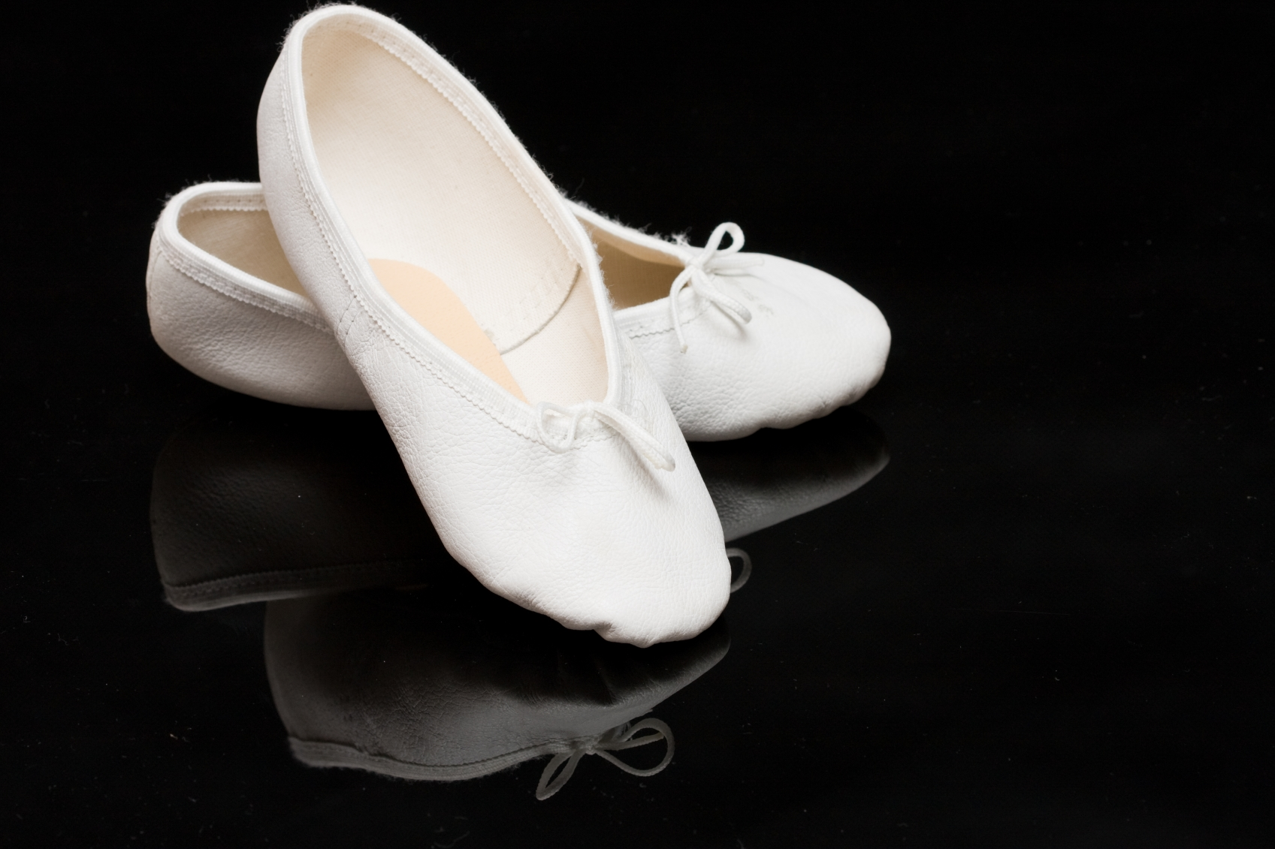
ALLIED ARTS
Enriching Our Communities Through
Advancement of the Arts

Slide 4
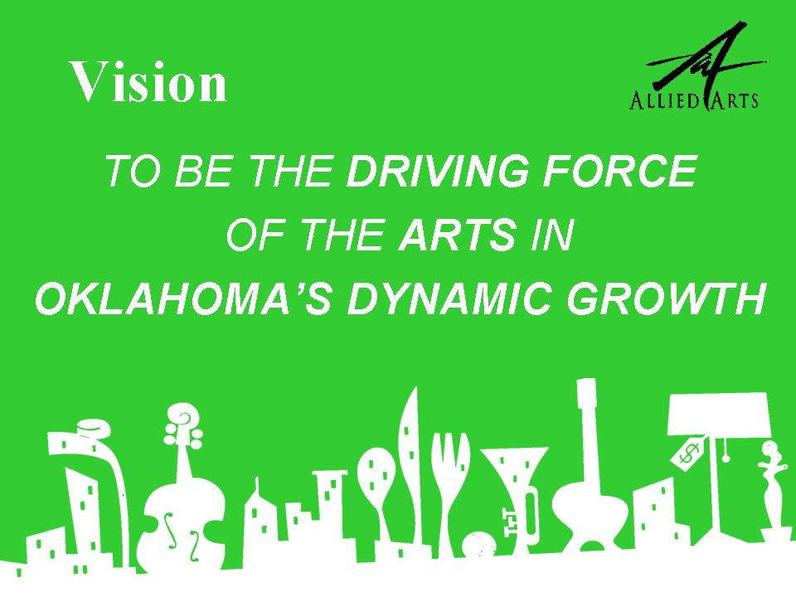

Slide 5
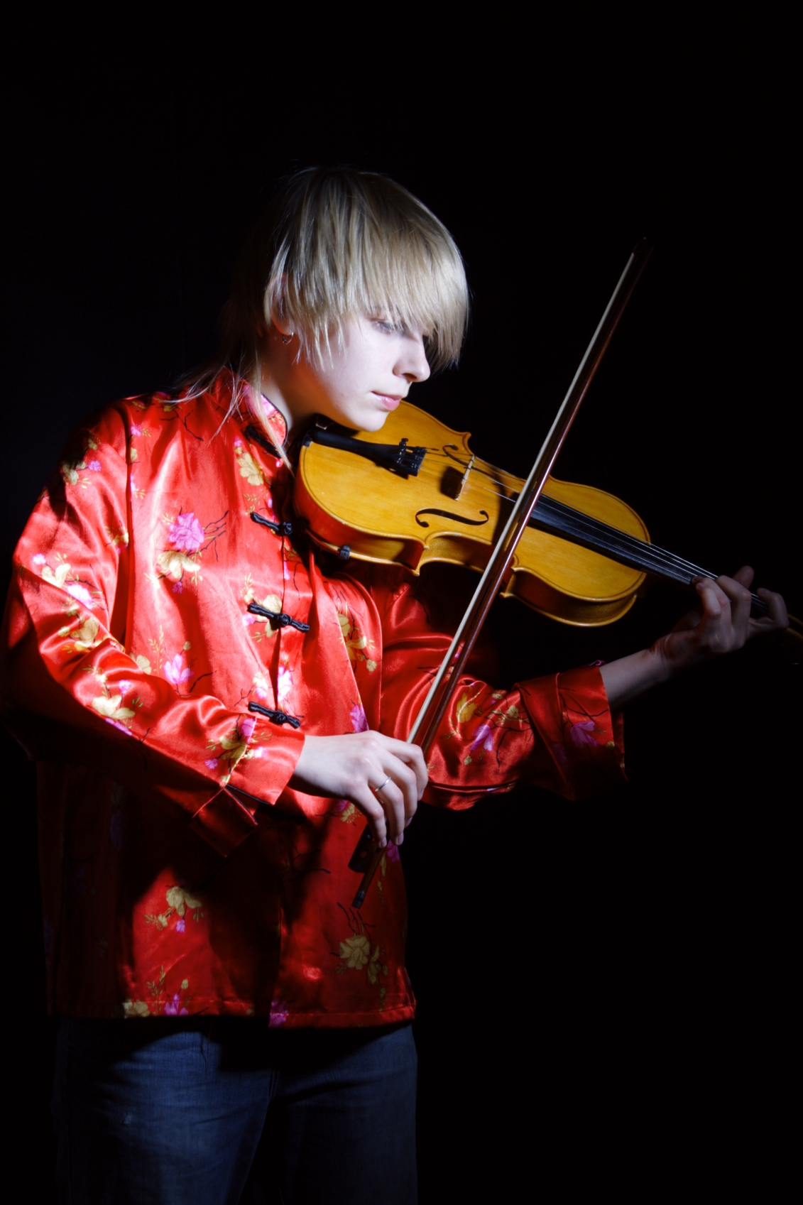
V i s i o n
OKLAHOMA’S DYNAMIC GROWTH
To be the driving force of the arts in

Slide 7
1
20
37
34,000,000
What is Allied Arts?

Slide 9
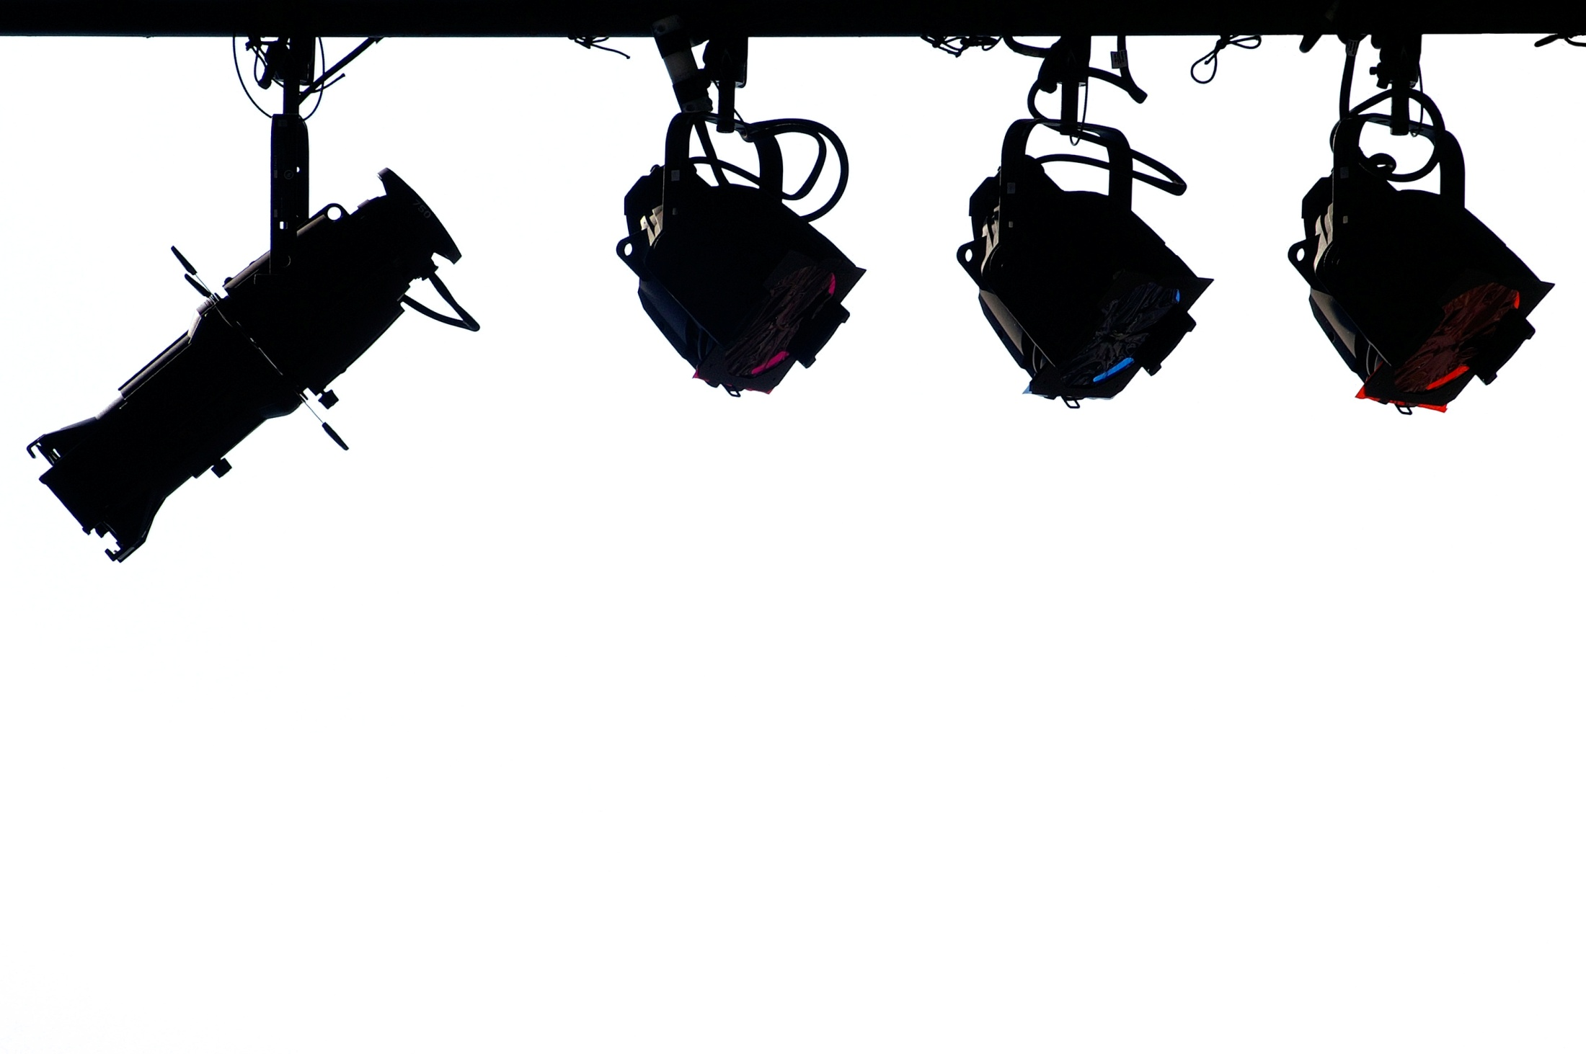
support

Slide 11
Why are funds needed?
25-33%
Ticket Sales

Slide 13
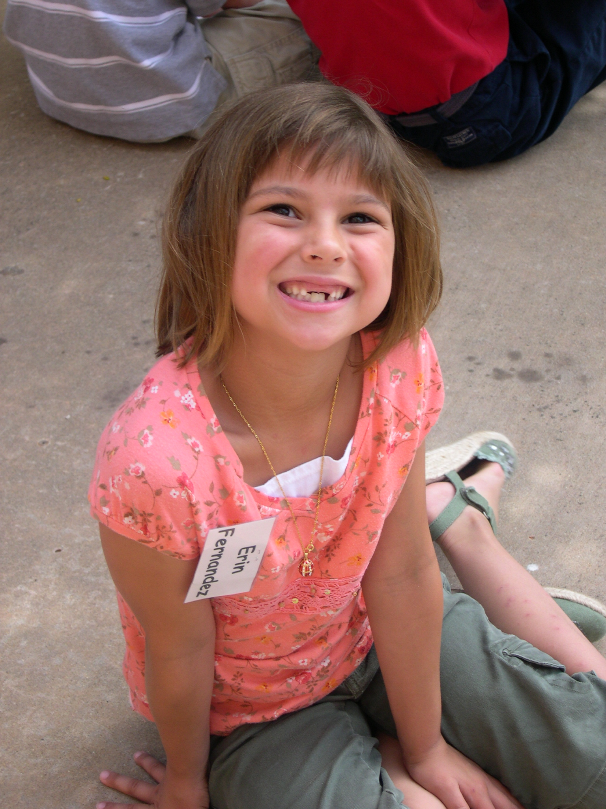
20
member agencies
WHY DONATE?

Slide 14
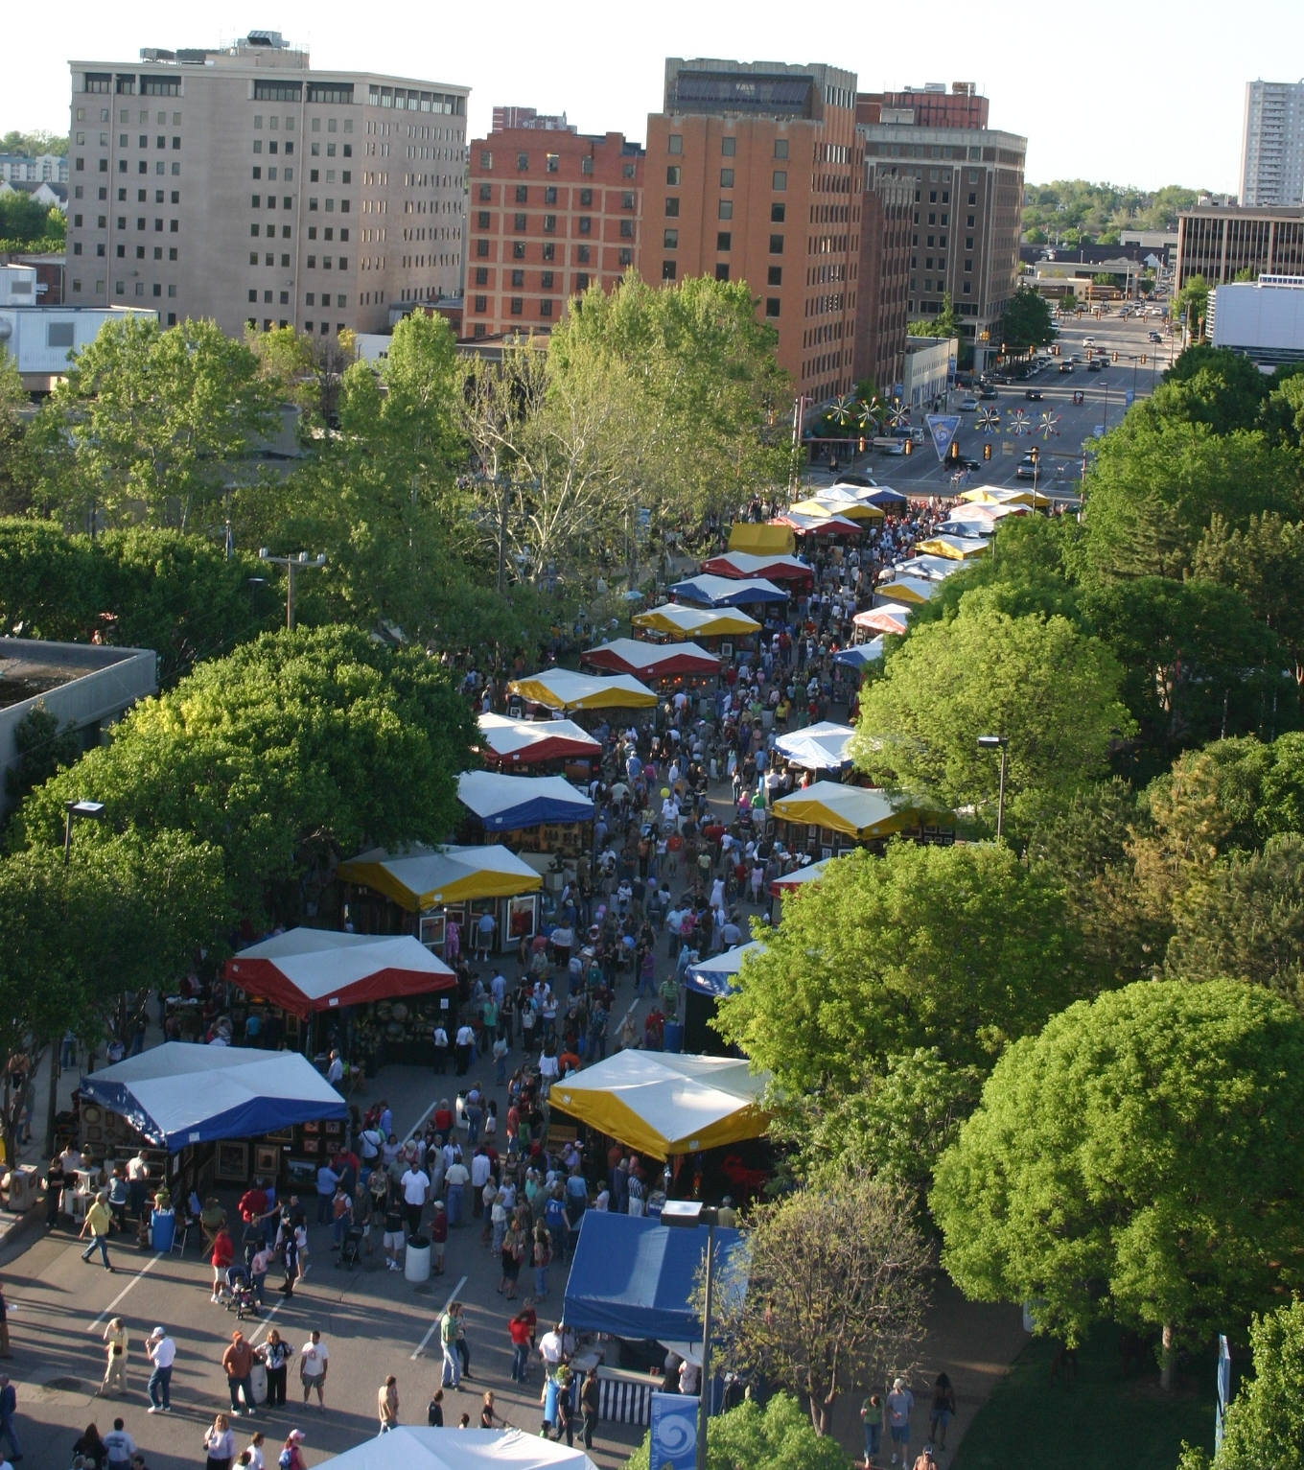
Festival of the Arts

Slide 15
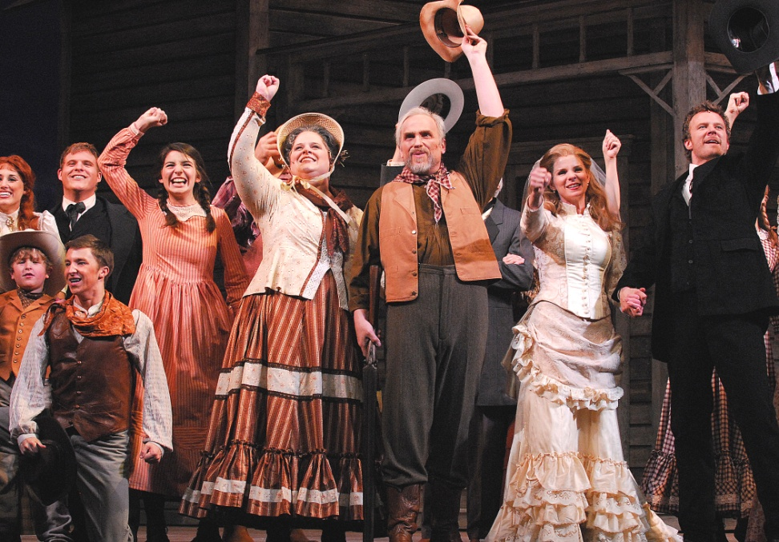
Lyric Theatre

Slide 16
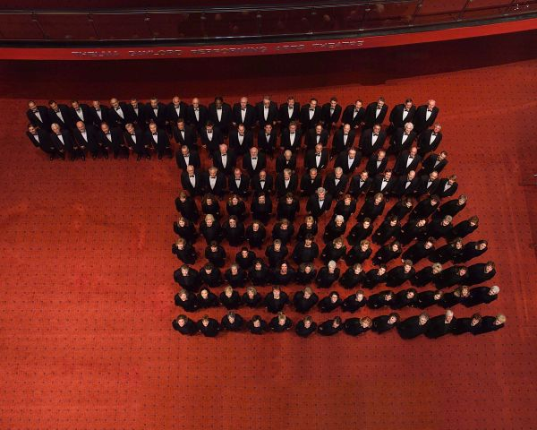
CANTERBURY CHORAL SOCIETY

Slide 17
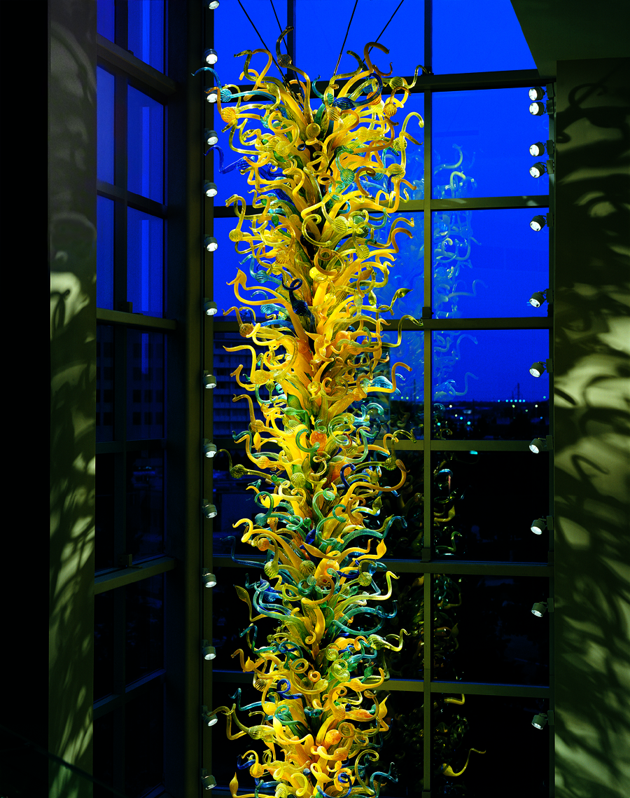
OKLAHOMA CITY MUSEUM OF ART

Slide 18
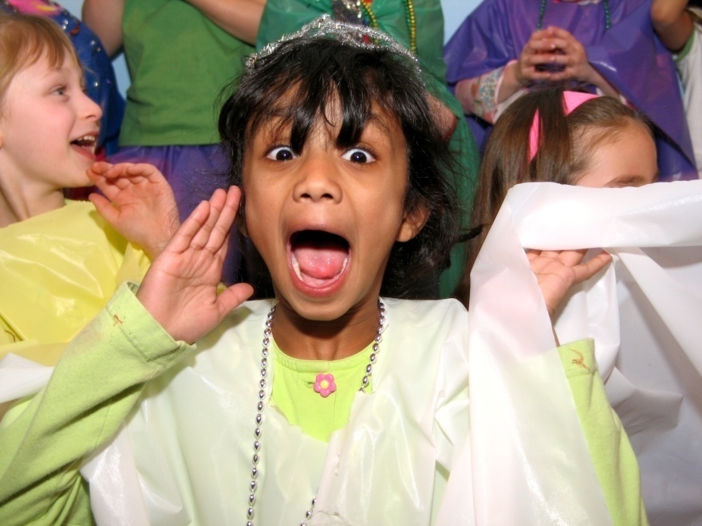
IMPACTING YOUTH

Slide 20
thank you
for supporting
AlliedArtsOKC.com
OKCityCard.com

