Slide 1
6
Keys to
Employee Engagement
RHETT LAUBACH

Slide 2
Are you drawing the best out of your team?

Slide 3
A trained brain is not very good at seeing things differently.

Slide 4
Encourage Up
Target Down
Strengthen In
Weaken Out
Make it Sharp
Rock the Gap

Slide 5
A Very Simple Word Association

Slide 6
youth

Slide 7
risk

Slide 8
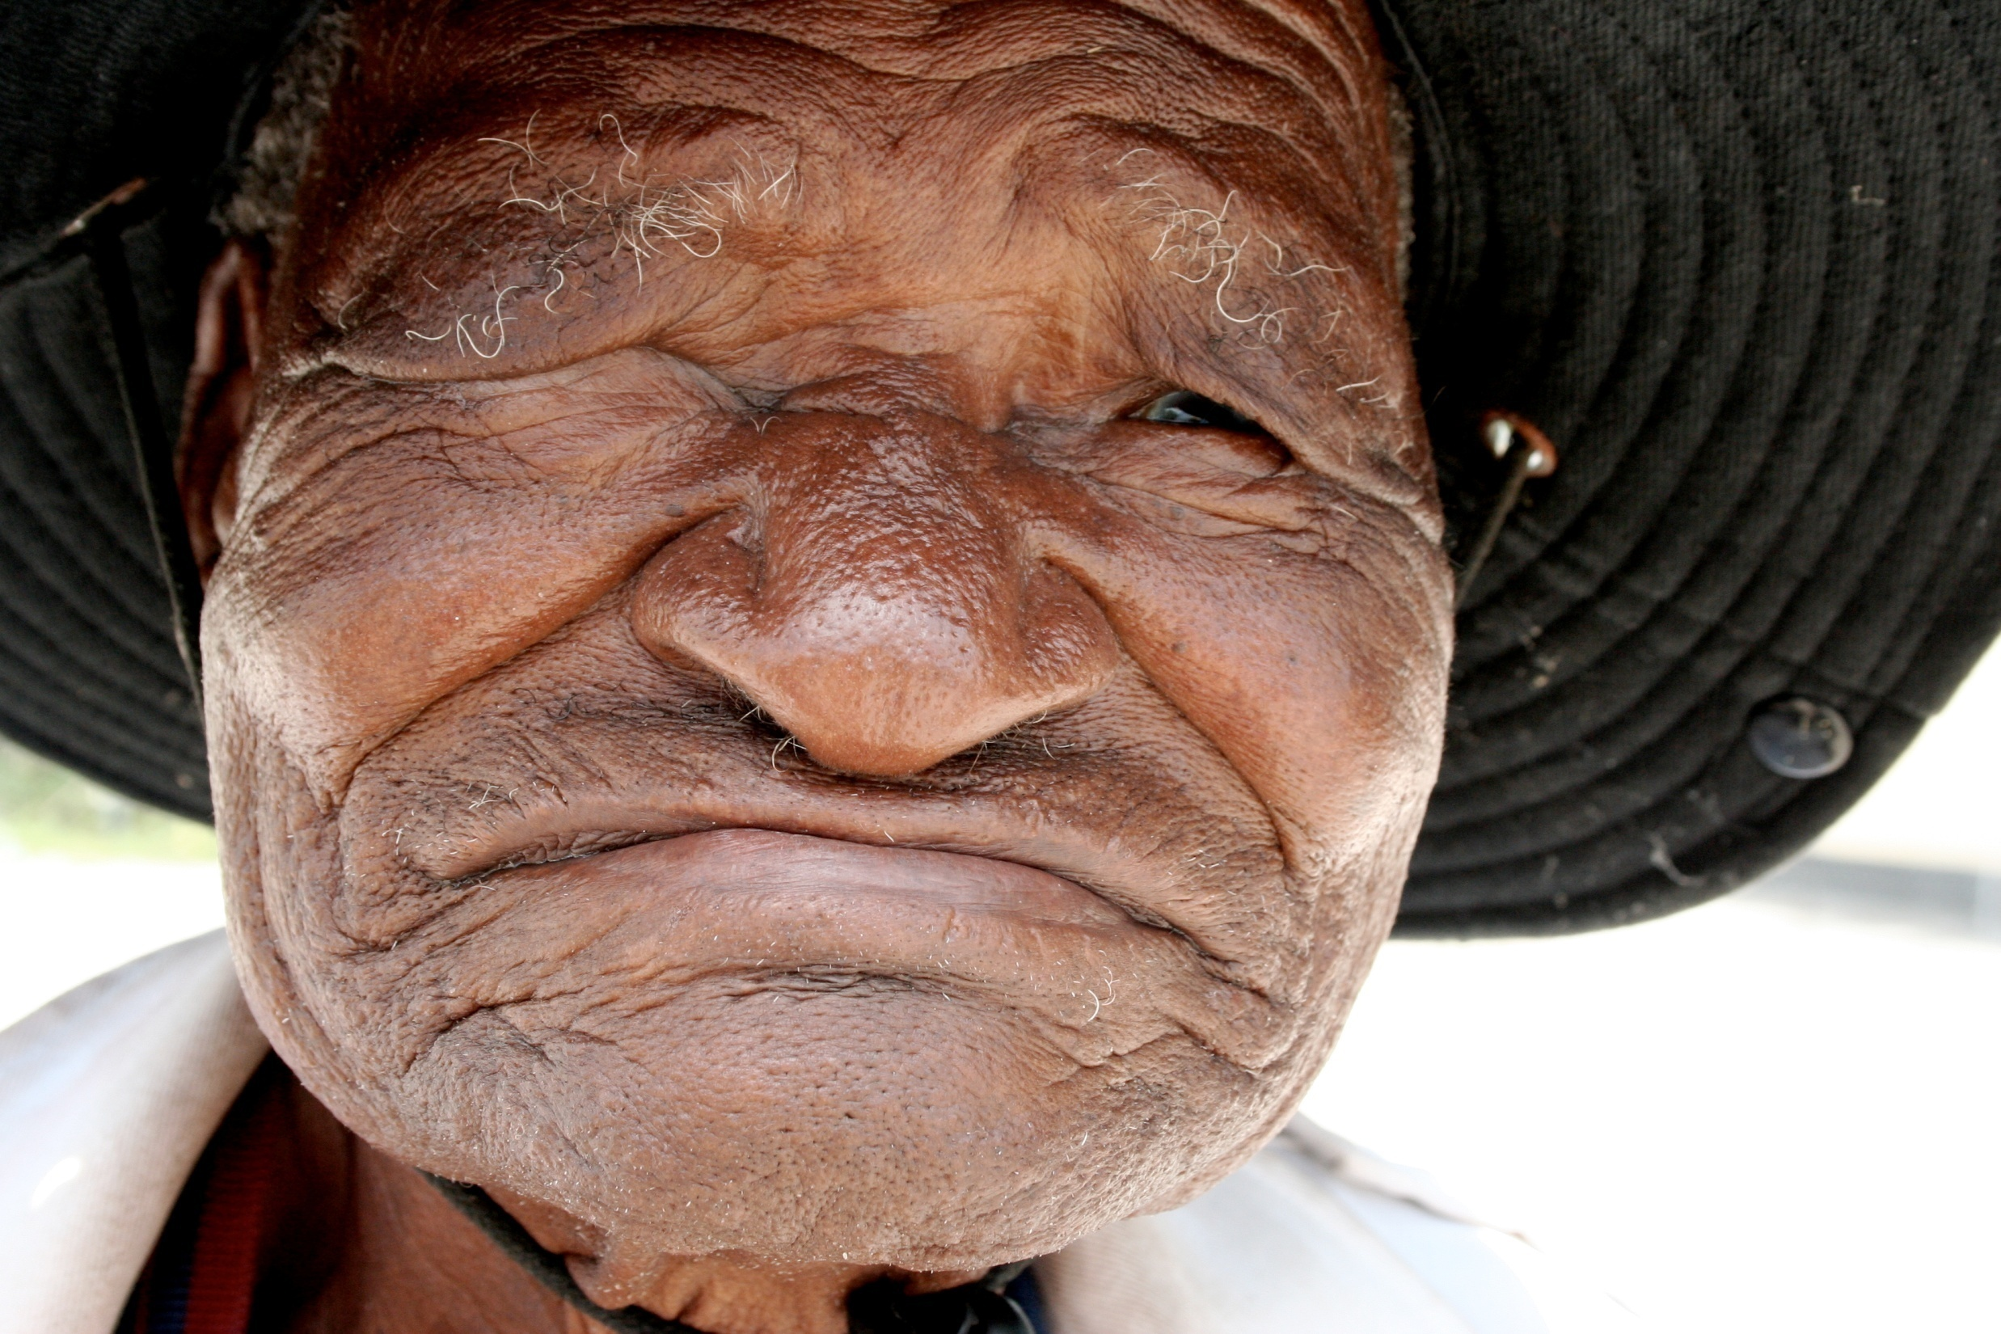
aging

Slide 9
leadership

Slide 10
emotions

Slide 11
training

Slide 12
lazy

Slide 13
5
Coaching
Conversations

Slide 14
BEST MOMENTS
CHALLENGING
ONE THING
NEEDS
PEERS

Slide 15
RHETT
YourNextSpeaker.com
www.YourNextSpeaker.com
www.AuthenticityRules.com
Facebook
Twitter - @RhettLaubach
LinkedIn
a production

Slide 16
Rhett Laubach
Edmond, OK

